Slide 1
08 April 2020
SéMInaire INTERCULTUREL SUR LES TRAUMATISMES
Indian perspective towards psychopathology and traumatism ( Part 2)
M.Sc Tanya Tandon
Doctorante / Assistante Dimplôme
tanya.tandon@unifr.ch
Spring Semester 2020

Slide 2
Title : Indian Concept of Trauma
Indian Understanding of Trauma :
Traumatic nature of events depends on cultural specific perception of them.
Cultural norms and values plays an important role in deciding the traumatic nature of the specific event.
For example, Indian population is vulnerable to many natural and man made disasters. So over the period of time, people learn to accept the disasters as a part of their life. Also due to extended family network in India, children in family are not very much unfamiliar with the adverse events like illnesses, accidents or death in a family . People acquire more degree of resilience.

Slide 3
Title : Indian Concept of Trauma
Indian Understanding of Trauma :
Indian mind set is based on external locus of control. Indians generally attribute responsibility for their situation to some external agency particularly their fate, demons, or some angry Gods or Goddess. This pattern of their appraisal of traumatic event may again shape their reactions to trauma differently.
Indian society is based on collectivist philosophy which means the importance of intimacy , family unit, and integrity is emphasized. This kind of philosophy permits easy sharing of problems with family members and other community members and creates readily family and social support.

Slide 4
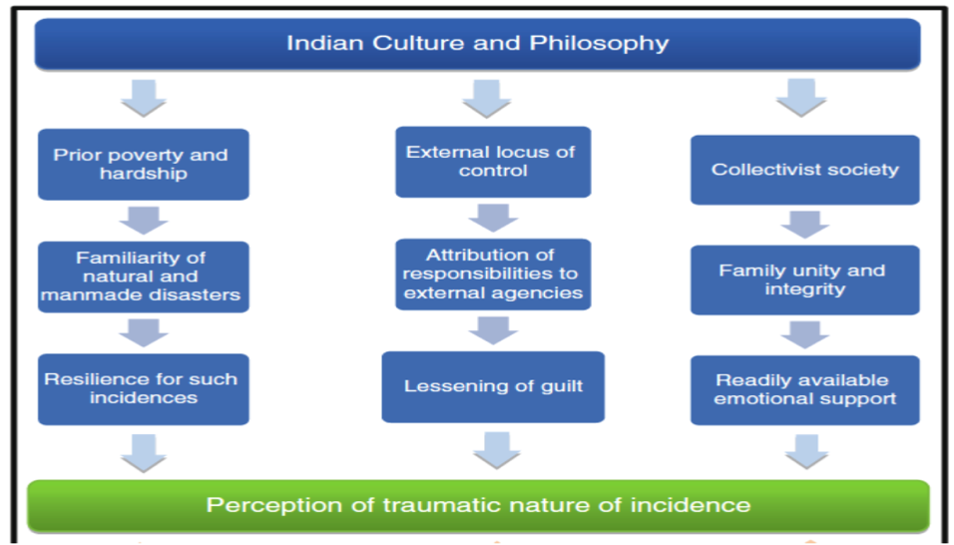
Title : Indian Concept of Trauma
Figure 1 : Indian Overview of Trauma

Slide 5
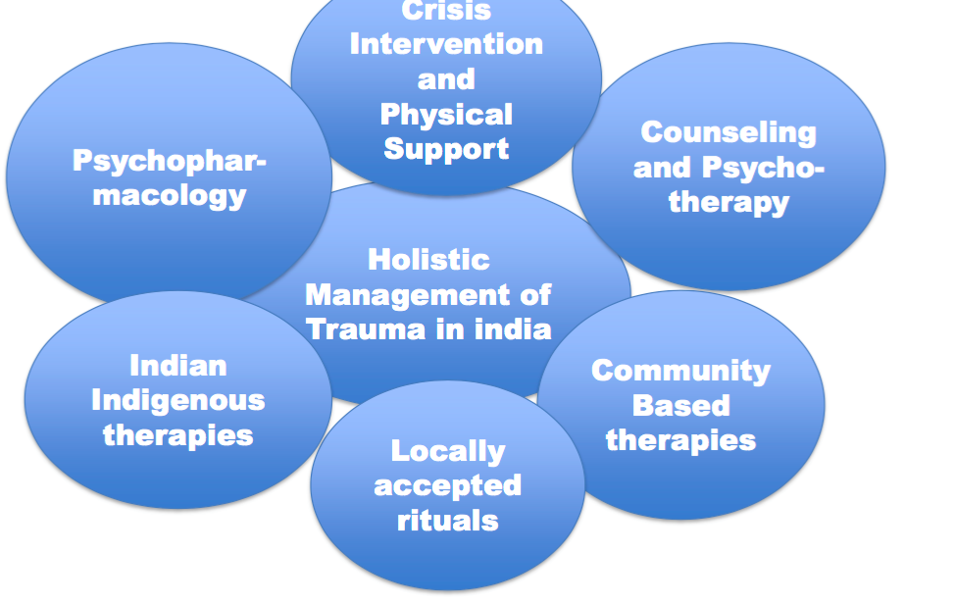
Title : Indian Concept of Trauma
Figure 2 : Holistic approach for management of trauma

Slide 6
Title : Indian Concept of Trauma
Cultural specific strategies to trauma:
Coping strategies with trauma are indigenous to that particular culture.
Like Indians believe in the “ law of karma” which states that happiness and sorrows of the present time are predetermined by individuals’ past deeds either in present life or in the past lives. Things do not happen because we make them happen, but they happen because they are destined to happen. So in some sense this view is protective from psychological consequences of trauma because it protects individual from guilt about his his/her present situation.

Slide 7
Title : Indian Concept of Trauma
Cultural specific strategies to trauma:
Religious Counselling : Therapies which are in keeping with local psychosocial framework are more easily accepted without stigmatizing suffering individual. It is very common in India to seek religious support when encountered with difficulty or stressful situations. This religious counselling may take various form. It includes
Either visit to temple or Dargah or some Guru.
It includes Darshans (blessed visions) of God or guru,
reciting prayers and spells, meditating, reading the
religious scriptures , fasting, and performing religious
rights like yagyas.

Slide 8
Title : Indian Concept of Trauma
Cultural specific strategies to trauma:
Faith Healing Therapies : Faith healing techniques are also the techniques which address person’s cultural beliefs in Indian subcontinent trauma.
Many times trauma is perceived as a result of curse of angry Gods, influences of demonic or other evil spirits ,
sorcery , or bewitchments.
To neutralize these effects, people in distress visit faith
healers. Indians also believe that when there is a misalignment of stars or planets, or calamity or misfortune occurs which can be relieved by observing fasts, prayers, or wearing specific gems and stones.

Slide 9
Title : Indian Concept of Trauma
Cultural specific strategies to trauma:
Indian Indigenous Therapies :
Indians also believe in their indigenous therapies which are perceived by them as more natural and side effect free . In India, Ayurveda and Yoga therapies are considered major indigenous therapies.
Ayurveda is a traditional Indian system of medicine which includes herbal medicines, dietary restrictions, and physical exercises. It is believed that Ayurveda not only takes care of physical aspect but also restores body-mind balance and has lesser side effects.
Yoga is another indigenous therapy in India which is widely used for the treatment of many psychological disorders including PTSD.

Slide 10
Title : Indian Concept of Trauma
Case study 1 :
An 18 year old Muslim girl presented with attacks of unconscious- ness, during which she sometimes scream and utter incomprehensible words. The attacks usually lasted about 1⁄2-2h, were associated with bizarre limb movements, and occurred whenever the topic of her marriage came up in the conversation. The attacks started following her engagement , three years earlier, to a distant cousin whom she did not want to marry . The attacks would clearly increase whenever this cousin visited their house. The relationship between the cousin’s family and the patient’s had gradually deteriorated. The patient’s family members called off the marriage. The family members and the patient had attributed her symptoms to sorcery performed by the cousin’s father.

Slide 11
Title : Indian Concept of Trauma
Case study 2 :
For the past 20 years, Geeta tried everything to cure her son. She sold precious family ornaments and her prized gold chain; she took him to faith healers, temples, and astrologists across India; and she even married him off. But nothing worked. Ramesh, continued to remain elusive: He talked no one but himself; he was socially withdrawn; and was often delusional, seeing things that no one else could. “I tried everything but nothing worked,” said Geeta, who lives in rural Bangalore, the capital city of Karnataka, a state in southern India. “I felt that an evil spirit had done black magic on him. I was fearful of being at home with just him. It’s very sad because the community treats us badly.”

Slide 12
Title : Indian Concept of Trauma
Case study 2 :
Ramesh was diagnosed with chronic schizophrenia and put on antipsychotic medication. Ramesh was connected with the public health care system after a community health worker recognized his symptoms. She referred him to a nearby primary health care center, eventually connecting him with a psychiatrist.
It was not an easy task. Nagaveni, a community health worker, recalled visiting the family ---- “four or five times because they believed it was black magic . They weren’t having any success with faith healers so they agreed.”

Slide 13
Title : Indian Concept of Trauma
Case study 3 :
A 13- year old Hindu girl presented with attacks of altered sensorium ( inability to think clearly) and vague fear of six months’ duration. During the attacks, she would throw off her bangles and toe rings ( which are the symbols of marriage in this culture). The symptoms had started following her marriage to a rich, widowed man much older than her. She had attained menarche only a month before her marriage , was naïve in her understanding of sexuality and was reported to have been very much upset and afraid of marriage. The patient revealed in an interview that she was afraid of her husband since marriage. The parents of the girl were convinced that her “ attacks” were due to Bhanamati sorcery by their neighbours.

Slide 14
Title : Indian Concept of Trauma
Case study 3 :
They believed that the neighbors were envious of their daughter marrying a much richer man. They were reluctant to accept the psychiatrist’s explanation that it could be the reaction to the stress of her marriage.

Slide 15
Explanations:
Despite the somatic manifestation of most of our patient’s illnesses, many of these patients had never consulted a medical doctor. These patients sought care from the system which they believed to offer the appropriate cure for the cause of their illness. Many people rely upon an indigenous health care system, one is that closely related to their socio-cultural belief patterns.
Here, the community health workers have to use the strategy of carefully avoiding confrontation of their belief systems and develop more innovative culturally compatible psychotherapeutic models applicable to these situation.

Slide 16
Mental Health neglected:
An estimated 150 million people across India are in need of mental health care interventions, both short and long- term, according to India’s latest National Mental Health. The Survey was carried out across 12 states, found that the overall prevalence for current mental health comorbidity was 10.6%.
Despite the high number of people who need care, mental health has been sorely neglected in India , due to rooted stigma, taboo and myths.
Poor awareness about the symptoms of mental illness, stigma and the lack of mental health services available has resulted in a massive treatment gap, with inadequate numbers of trained mental health care professionals. The survey found that between 70% and 92% of those in need of mental health care failed to receive any treatment.

Slide 17
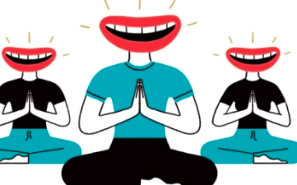
Conclusion :
Here is something interesting to follow :
LAUGHTER YOGA SESSION
https://www.youtube.com/watch?v=GzvabRX10H8&t=351s
Thank You!!!!

